Slide 1
Protein phosphorylation on disordered regions

Slide 2
Overview
After analyzing the data on our phosphoproteomics experiment we realized there were several proteins involved in RNA metabolism
Some of these proteins have been shown to engage in the formation of membrane less organelles by means of liquid phase separation (LLPS)
This proteins usually have intrinsic disordered regions (IDRs) in their sequence, which are partly responsible for their ability to undergo LLPS
Since lately many other proteins involved in a variety of processes (chromatin remodeling, nuclear pore complex, etc) have been shown to undergo LLPS, we wondered if protein phosphorylation might be involved in the regulation of such process
Is there a relationship between protein phosphorylation and protein disorder?
Is protein phosphorylation partly involved in regulating LLPS?
Notes:
Here find a brief description of our rationale and why our phosphoproteomics experiment has been leading us to IDRs and LLPS

Slide 3
Method: protein classification
First we extracted all the proteins we detected from our experiment and divided them in the following fashion:
‘All’: all proteins for which a phosphosite (pSite) was detected
‘ANOVA_sig’: all proteins that exhibit at least one pSite with a statistically significant change in intensity through our timeline
‘Exit_metaphase’: proteins exhibiting at least one pSite with a clear trend of high intensity before fertilization and 15 minutes after fertilization. Then drastically dropping intensity for the rest of the timeline (cluster shown on heatmap in the other presentation)
‘Oscillating’: proteins exhibiting at least one pSite whose change in intensity is coupled to cell divisions (likely CDK1 targets) (cluster shown on heatmap in the other presentation)

Slide 4
Method: calculating expected number of phosphosites
Second, in order to asses if proteins are more prone to be phosphorylated in their IDRs, we did the following
Compare the actual number of pSites detected in IDRs, with the expected number of pSites that should be present in this region, depending on its size
So if a protein is largely disordered we would expect most of pSites to be in a IDR, whereas if it is 50% ordered and 50% disordered, expectation would be that pSites would be roughly distributed equally between the two types of regions

Slide 5
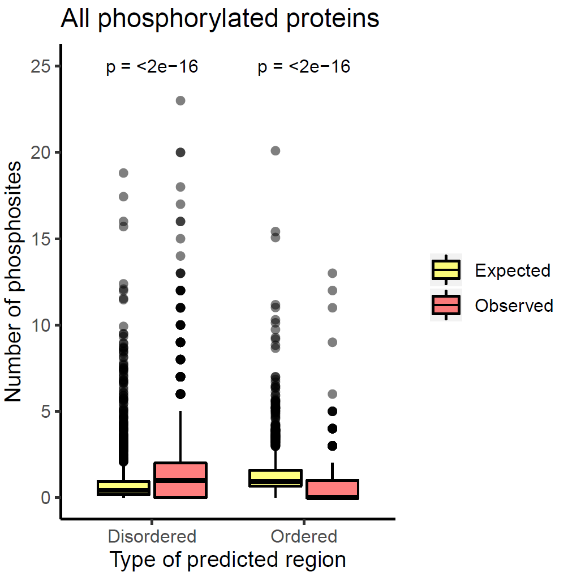
Results
This plot shows the number of phosphosites per disordered (and ordered) region, from all the proteins we detected to be phosphorylated in our experiment
Most of the proteins have phosphosites located to their disordered regions

Slide 6
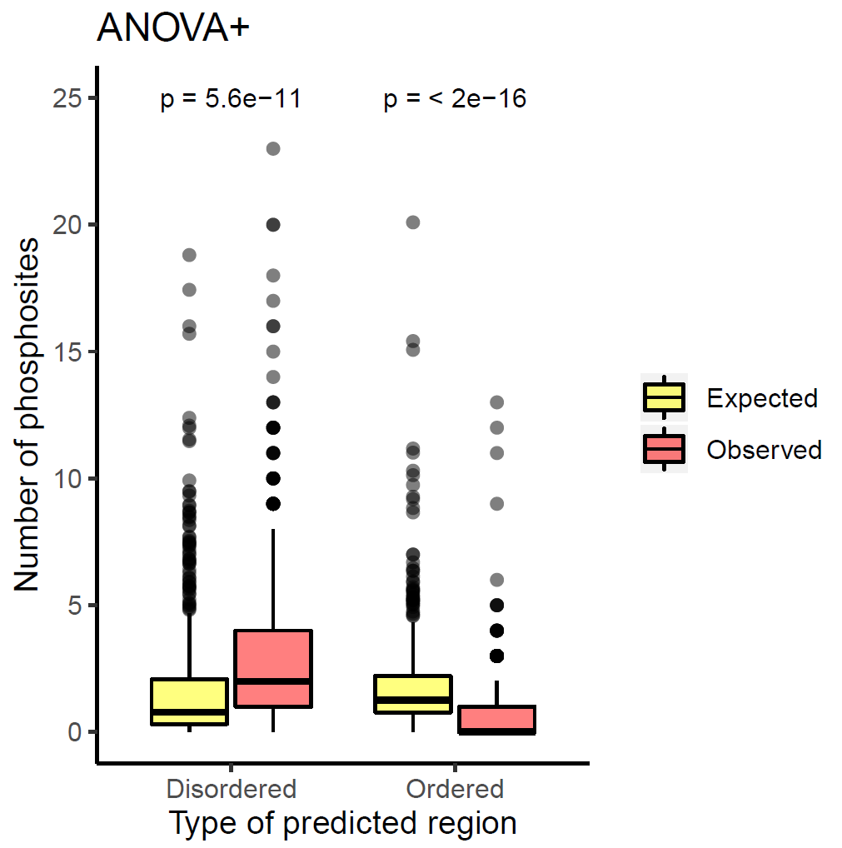
Results
When focusing only on those proteins that exhibit significant change through our timeline, is more clear that these proteins have a tendency to be more phosphorylated in their IDRs

Slide 7
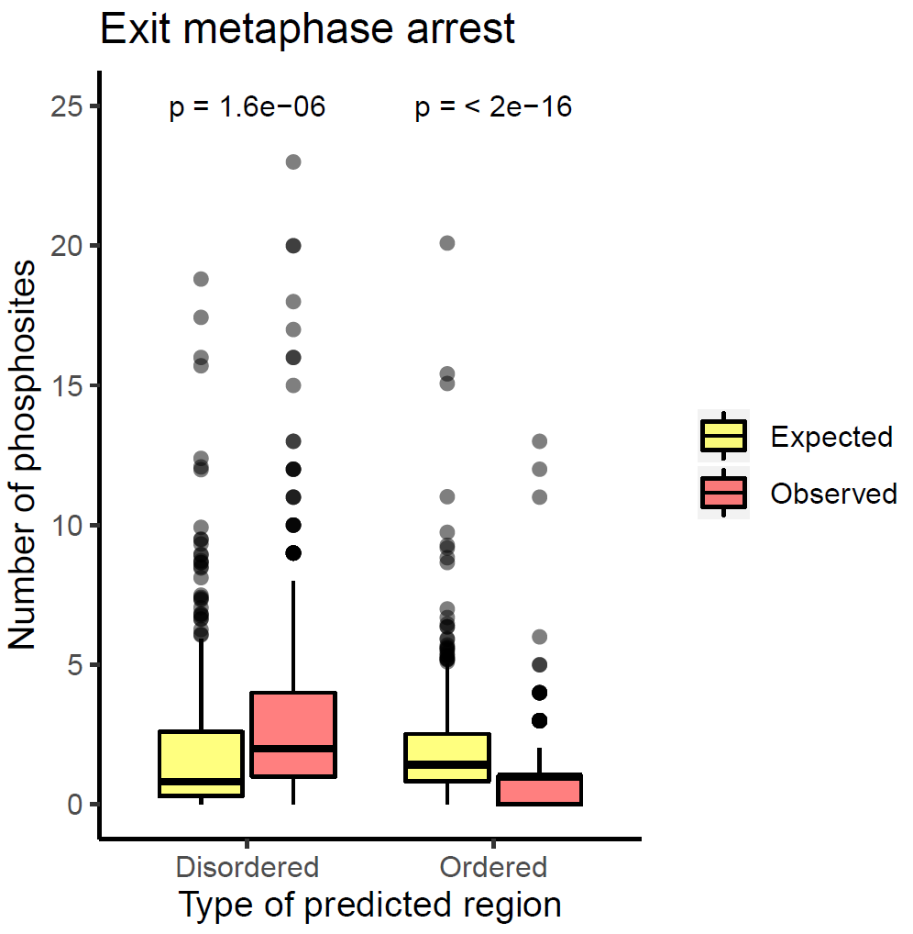
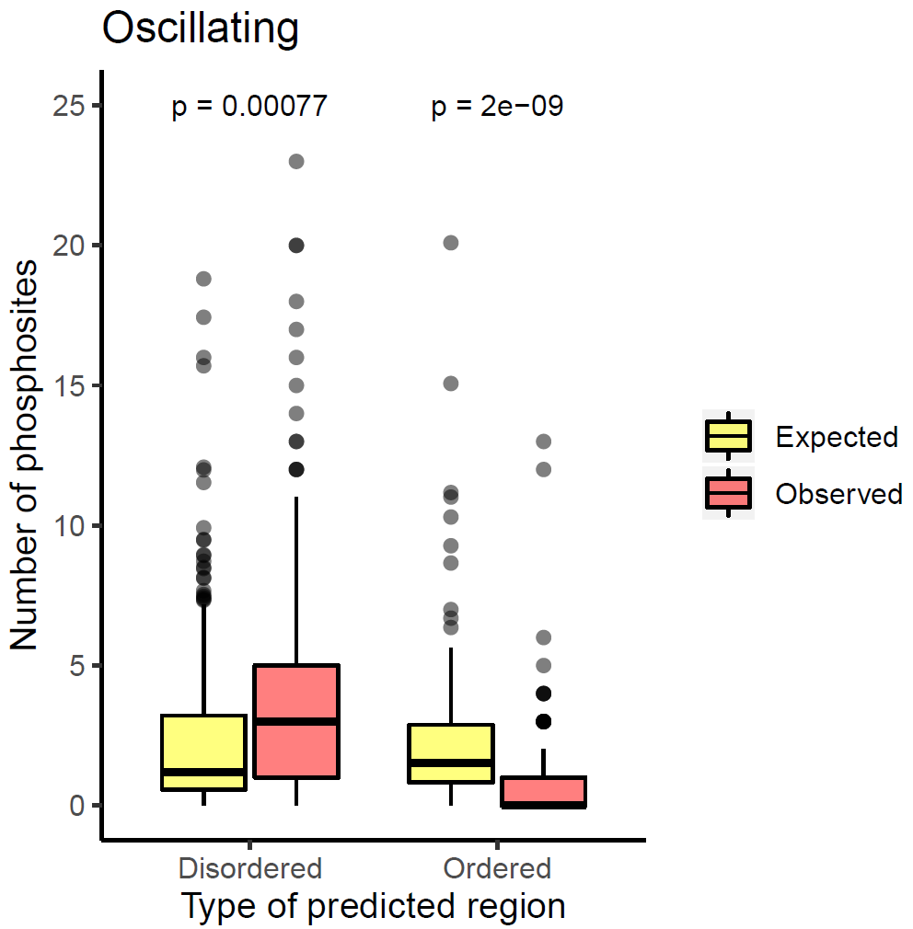
Results
Same can be seen in proteins that have at least one phosphosite in the ‘Exit from metaphase’ cluster and in the ‘Oscillating’ cluster

Slide 8
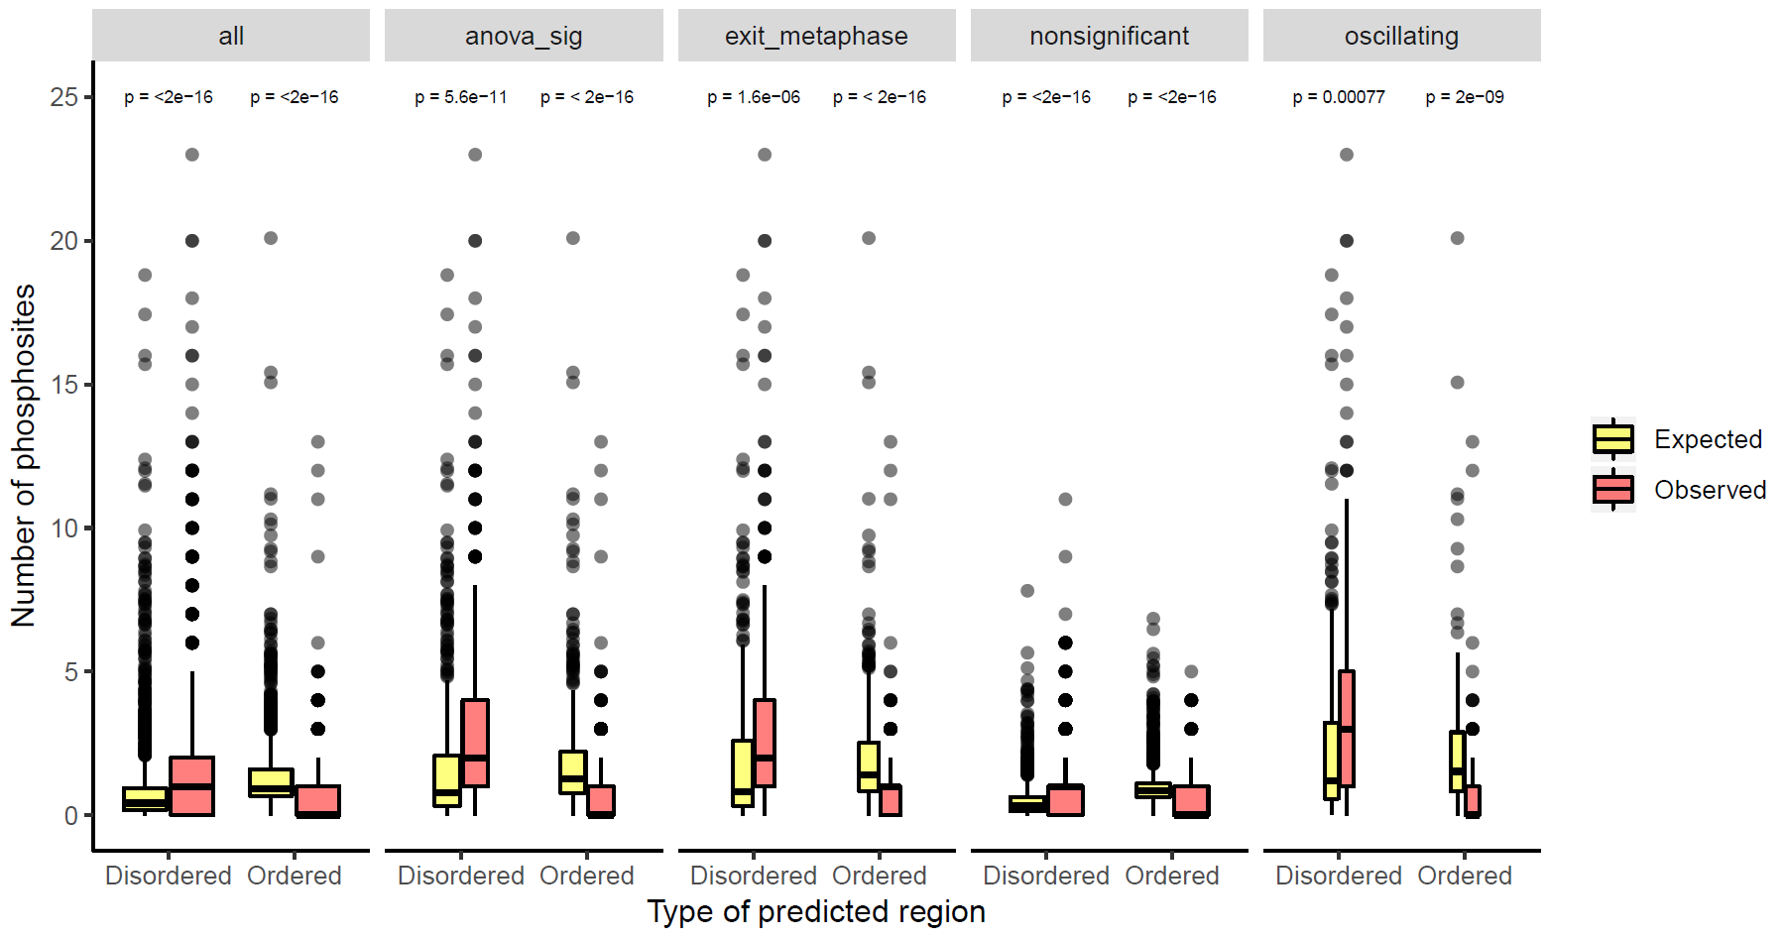
Summary
This plot summarizes all the comparisons shown before, also including the proteins that displayed non significantly changing phosphosites (arrow)
The latter shows how proteins that displayed at least one changing phosphosite through time are more prone to be phosphorylated in their IDRs
Something similar was already reported by Tyanova et al, 2013. PLoS Computational Biology, 9(1): e1002842
Notes:
This plot shows all the comparisons shown before, also including the proteins that displayed non significantly changing phosphosites.

Slide 9
Results
Now, in order to asses which proteins are concentrating pSites in their IDRs, and if this is statistically significant we did a Binomial Test, which gave the following results

Slide 10
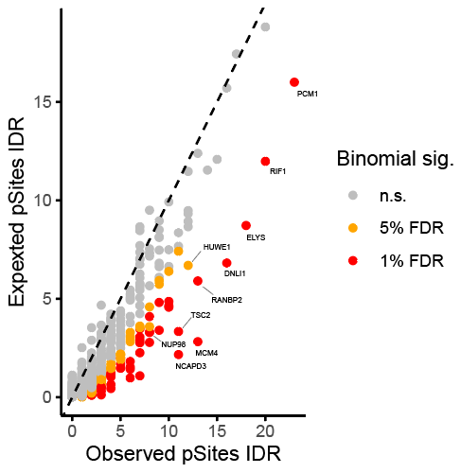
Results
For ANOVA significant proteins
This way we were able to identify proteins highly phosphorylated in IDRs, which suggests phosphorylation might be regulating their LLPS
On the next slide find a short list of the proteins highlighted in this plot

Slide 11
Short list of some proteins that might be undergoing LLPS
Protein | Observed pSites IDR | Expected pSites IDR | p value | Clear trend pSite | PSPredictor Score (>0.5 means high likelihood of undergoing LLPS in vitro)*
PCM1 | 23 | 16 | 0.0004 | Oscillating | 0.8827
RIF1 | 20 | 12 | 0.0006 | Oscillating | 0.1117
ELYS | 18 | 9 | 2e-6 | Oscillating | 0.8607
MCM4 | 13 | 3 | 1e-8 | Oscillating | 0.1511
RANBP2 | 13 | 6 | 0.003 | Oscillating | 0.59
TSC2 | 11 | 3 | 7e-6 | Oscillating | 0.4683
TDRKH | 10 | 5 | 0.001 | Oscillating | 0.7519
CAF1B | 8 | 3 | 0.0002 | Oscillating | 0.9967
NUP98 | 8 | 3 | 0.003 | Oscillating | 0.8727
AAK1 | 7 | 3 | 0.007 | Oscillating | 0.9995
SF3B1 | 7 | 3 | 0.003 | Oscillating | 0.3294
ATP2B1 | 6 | 1 | 2e-5 | Oscillating | 0.0094
CDC6 | 6 | 2 | 0.002 | Oscillating | 0.1033
DYNC1LI2 | 5 | 2 | 0.004 | Oscillating | 0.2801
ARMC9 | 4 | 1 | 0.004 | Oscillating | 0.014
GPHN | 4 | 1 | 0.006 | Oscillating | 0.4447
MELK | 4 | 1 | 0.009 | Oscillating | 0.0052
*From Li et al, 2019. LLPSD: a database of proteins undergoing LLPS separation in vitro. Nucleic Acids Research
http://bio-comp.org.cn/llpsdb/home.aspx
Notes:
Explain that I am attaching Excel with full data
Explain where the prediction comes from
And highlight a few examples like PCM1, MCM4, CDC6

Slide 12
Notes
Find attached an excel sheet with the full results from this analysis
From previous table I highlight a few examples:
Some proteins like PCM1 have already been shown to undergo LLPS (Rai et al, 2018. Nature, 559, 211-216)
Some others like MCM4, are not that highly disordered (check disorder according to IUPRED on next slides) but have a high number of pSites in their IDR
MCM proteins might not phase separate on their own, as shown by Parker et al, but their IDRs might be involved in their ability to be enriched in condensed phases containing other proteins (Parker et al, 2019. Elife, 8: e48562)
I briefly highlight these examples, but I think there are more that might be equally interesting

Slide 13
MCM4
DNA replication licensing factor MCM4;
Highly phosphorylated on its N terminal IDR. This IDR is conserved among different species. Following slides show the disorder prediction by IUPRED

Slide 14
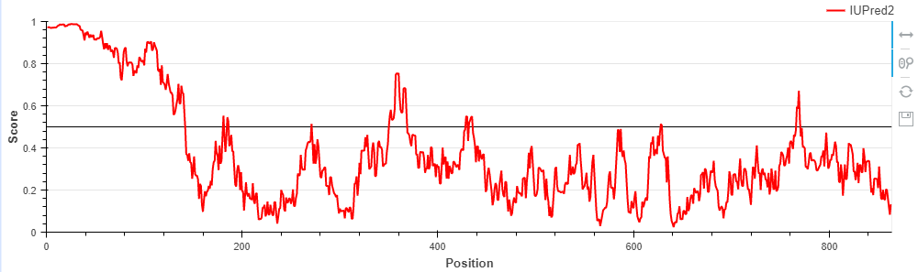
X. laevis

Slide 15
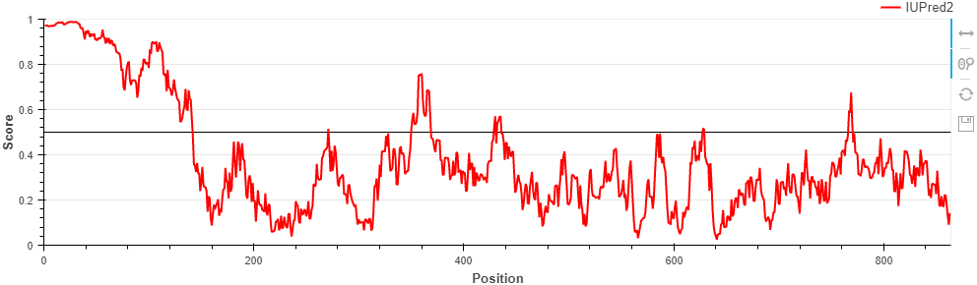
X. tropicalis

Slide 16
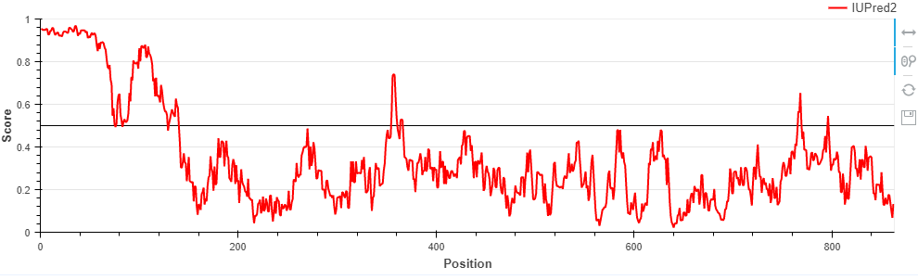
M. musculus

Slide 17
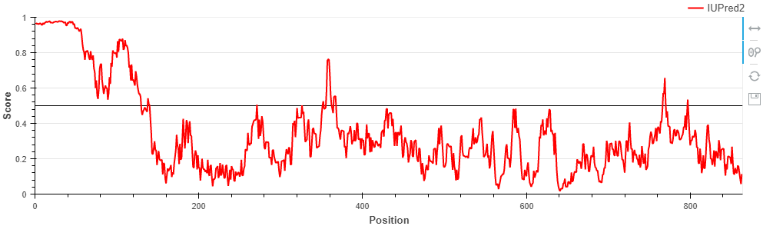
H. sapiens

Slide 18
Conclusions
There is a body of evidence in literature that shows how PTMs, including phosphorylation, play a role in LLPS regulation (reviewed in : http://www.jbc.org/content/early/2018/12/26/jbc.TM118.001189)
Other publications have linked LLPS to cell cycle related events (a few cited before in this presentation)
Lately, new phase separated condensates have been described in processes such as DNA replication and heterochromatin formation
Our dataset includes proteins involved in a variety of these processes, with some of them already known to undergo LLPS
Overall, our hypothesis is that many of our pSites show that kinases, such as CDK1, are regulating LLPS throughout the cell cycle

